Slide 1

Update on Water Supply

Slide 2

Water sampling from 2012 until now

Slide 3
Water sampling from 2012 until now

Slide 4
Water supply scheme

Slide 5
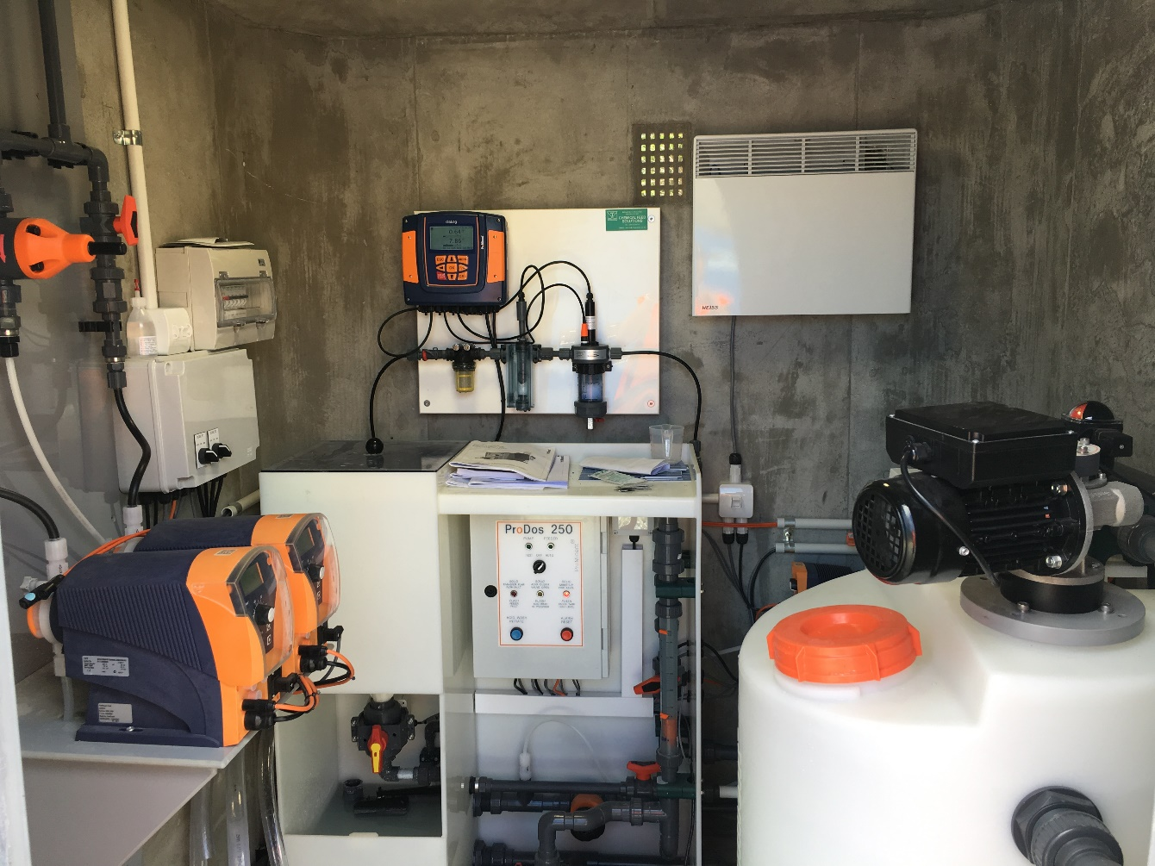
Current Chlorination Setup

Slide 6
General Water Supply Background Information
All QLDC supplies required to comply with regulations since July 2014
  Recognised meeting Drinking Water Standards (DWS) take years to implement
    Capital and operational investments
  Included in 2014 version of 30 Year Infrastructure Strategy
  Implemented treatment updates at higher risk sites
  Programme to update Water Safety Plans (WSP)
During HN Inquiry: Letters from DWA, Minister Health & LG, Director General of Health, LGNZ and Water NZ
Following HN Inquiry Stage 2 being released
  QLDC completed review of the findings and recommendations

Slide 7
Approach To Date
Legacy Water Safety Plans (WSP) for all supplies
  ~80% of water supplied disinfected
Sought expert advice
  Comprehensive review / update of all WSPs
  Detailed risk assessment of QLDC groundwater supplies
Water supply masterplans for all communities
  To meet existing and future/growth needs
Developed programme to meet DWS by 2028
  Included into Draft 2018 LTP
  Completed programme of precautionary disinfection for remaining networks

Slide 8
Havelock North Inquiry
Key Recommendations
  Removal of secure groundwater status
  Mandatory multi-barrier treatment of all public water supplies
    Includes requirement for a residual disinfectant in the network
  Establishment of an independent water regulator
  Collaboration and dedicated water suppliers
  OAG oversees Implementation of Inquiry Recommendations

Slide 9
Immediate DWA Changes
Observed changes in DWA behaviour
  Director General requirement to enforce current DWS
  DWA shift/firmed in regulatory approach
Shift in focus on WSPs
  Must be up to date, must be thorough and implementation ensured
  QLDC prepare WSPs, DWA review and Approve WSPs
  DWA actively seeking evidence Approved WSPs being implemented
Glenorchy WSP Update: “disinfection must remain on”
  Requirement under DWS “all practicable steps”

Slide 10
Risks
Highlight the residual risk identified by WSP’s
  Supply risks from source
    Runoff, and water body users
  Treatment risks
    Measuring / capturing and storing proof that treatment is operating correctly
  Network risks
    3rd Party damage, new connections (refer following slides)
    Shared ownership – Goldfields etc
    In areas with high levels of growth

Slide 11
Distribution network risks
  Illegal/unapproved connections to water networks,
  inappropriate disinfection of new connections,
  third party damage to networks,
  animals and other contamination entering water storage reservoirs,
  contaminated backflow from customers into the supply network,
  depressurising the supply with extreme demand (i.e. firefighting),
  biofilms growing within aged pipes,
  septic tanks and wastewater pipe breaks near water sources and water pipes, and
  water pipeline deterioration and breakages.

Slide 12
Unapproved connections
  3rd August 2017 Lewis Road, Kelvin Heights

Slide 13
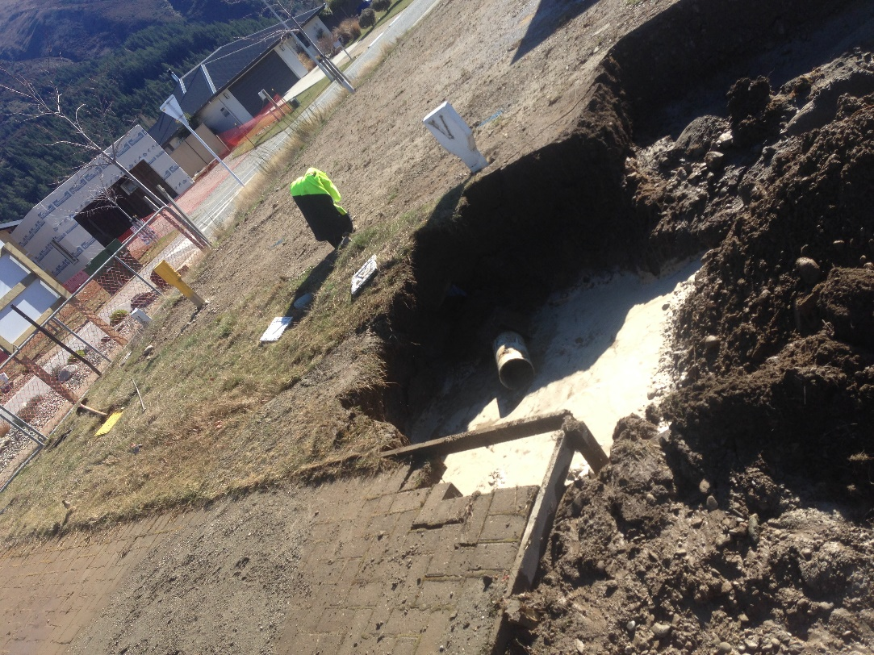
Near Miss - Hawea
22nd August 2017
  3rd party collapsed septic tank and broke public water pipeline – cross contamination risk
  By the time Veolia responded the contractor had already shutdown the main
  depressurising potable water supply

Slide 14
Next Steps
Continue updates to WSP’s with operations/maintenance changes
  Demonstrate compliance with DWA Approved WSP’s
    Ongoing chlorination of the network
Develop options for acceleration of meeting DWS
  Mitigate remaining risks
Start engagement with other water suppliers for synergies
  Approaches, capital investment

Slide 15
LTP 2018 - 2028
In the first three years of the LTP following projects are planned:
  Water supply upgrade - bores
  New reservoir
  Water supply upgrade - treatment
  With a total value of ~$2,500,000

Slide 16
Questions?

