Slide 1

Strategic Review of Libraries
Task Force workshop
28 January 2014
Notes:
1

Slide 2
Approach - Triangulation
Qualitative
(Stakeholder interviews)
Quantitative
(Community Survey)
Desk top research
Options Analysis
Recommendations and reporting

Slide 3
Stakeholder interviews
Notes:
Explain the process for each source of information

Slide 4
Interview findings
Currently a place of books
Well liked by users for what they are; but little thought as to what they might be
Systems, processes, controls have been inconsistent; leadership had to improve
Issues to consider: technology, population growth, partnering e.g. schools
What would draw in more non-users?

Slide 5
Community survey
Notes:
1765 responses
Mostly resident, library users responded
97% library members
14% non-resident
Very low child representation in survey
1% under 18 yrs of age
Respondent – 42% were couple living on their own
23% with predominant school aged children
74% female
1% under 18, 3% 18-24, 21% 65or above

Slide 6
What the survey tells us
The ‘average’ library visitor:
  Is a female, working full-time, 51 years old
  Visits a library once a fortnight (drives there)
  Borrowed and returned books
  Has no reason to visit more often (no barriers)
    (OR: lives out of the region)
  Was there in the last month, during a weekday afternoon, for 30 minutes

Slide 7


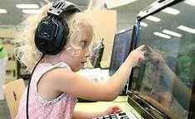
  The ‘average’ user (continued)
  Is satisfied with the service
    Happy with the days
    But wants different hours (24% want evening hours)
  Is prepared to pay $29 for the services offered
    $61 for those willing to pay something
    $68 is the recent per capita cost

Slide 8
Performance gaps?
Not fully surveyed, and missing non-user perspective
Performance versus importance
  very positive results
Under performance
(negligible)
Significant over performance

Slide 9

Desk Top research
Research and analysis of QLDC existing data, plus nationally available comparison data
Benchmarking
Research and analysis of environmental trends, best practices
Notes:
Explain the process for each source of information

Slide 11
Reasons – cost drivers
Branches
More branches = higher cost
Opening hours
Longer hours = multiplier effect (on branches)
Staff levels
Staffed versus self-service
Stock levels
Direct holding costs plus turnover related costs

Slide 12
Opening hours

Slide 13
Stock turn: between 0.2 and 6.4 per annum; avg 3.3
QLDC: 4 (issued three times a year)

Slide 14
Identifying benchmark councils
Benchmarking
  South Taranaki
  Selwyn
  Taupo
  Thames-Coromandel
  Southland
  Waitaki
Notes:
Explain the process for each source of information

Slide 15
Profile of benchmark libraries
 | QLDC | South Taranaki | Selwyn | Taupo | Thames-Coromandel | Southland | Waitaki
Population (2013 census) | 28,224 | 26,577 | 44,595 | 32,907 | 26,178 | 29,613 | 20,826
Land area (km²) | 8,467 | 3,576 | 6,420 | 6,350 | 2,297 | 30,401 | 7,152
Total libraries | 7 | 7 | 4 | 3 | 3 | 7 | 4
FTE's | 17.9 | 19 | 14.43 | 12.975 | 7.6 | 14 | 9.5
Holdings | 107,377 | 82,911 | 99,500 | 91,923 | 60,350 | 231,461 | 87,601
Registered members | 14,071 | 12,226 | 22,120 | 28,431 | 12,774 | 21,813 | 14,539
Total operating expenditure | $1.9m | $2.5m | $1.8m | $1.9m | $1.2m | $1.5m | $1.0m
Total sundry income | $135,640 | $72,723 | $75,724 | $75,561 | $94,189 | $38,525 | $46,864
Notes:
Explain why benchmark were chosen

Slide 16
Findings
QLDC membership at the lower end of this group
However it has the highest issues per capita.

Slide 17
Findings
QLDC has the second highest operating expenditure per capita behind South Taranaki – in part reflecting the cost of having many branches.
However, QLDC has comparable operating expenditure per issue due to the high number of issues per capita.

Slide 18
Findings – Satisfaction
Overall QLDC residents satisfaction survey is on the low side of this group

Slide 19
Findings - Community Survey
Ratings of what’s most important
90% range | 80% range | 70% range | 60% range
Range of books Face to face assistance Staff helpful & friendly Books – non- fiction, reference Books - fiction | Availability of books that I want Location accessibility Comprehensive catalogue that is easy to search | Opening hours Information that tells where to find things (signage, labels) | Range of reference services, information Quality of building Online resources, database, information Library website

Slide 20
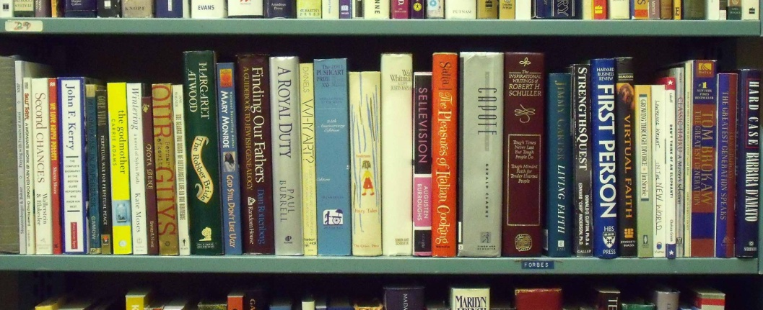


Findings -Stock
Good satisfaction with the range of stock in Wanaka
Stock management – Require good systems, streamline workflow, review acquisition, cataloguing, processing
Relationship with CODC is valued - opportunity

Slide 21
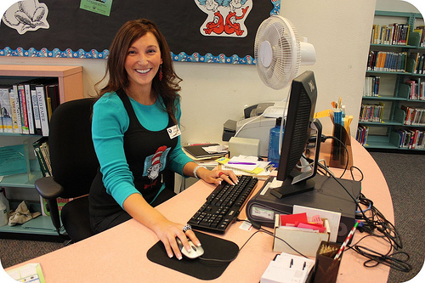
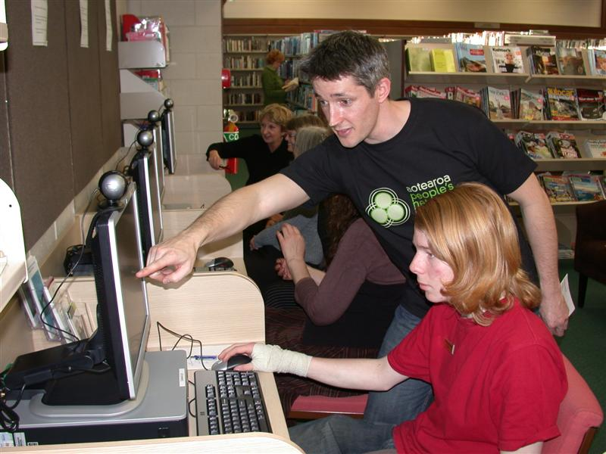
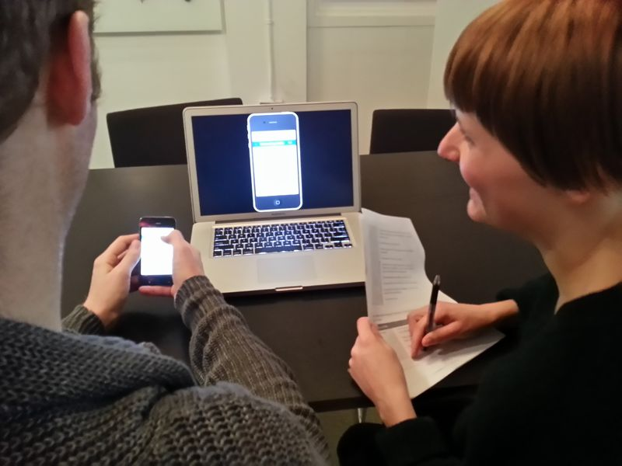
Findings – staff
Lack of leadership and direction in the past
Staff are positive about the future

Slide 22
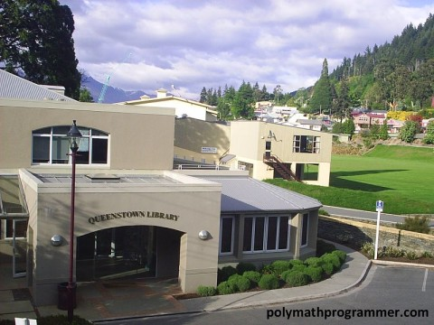
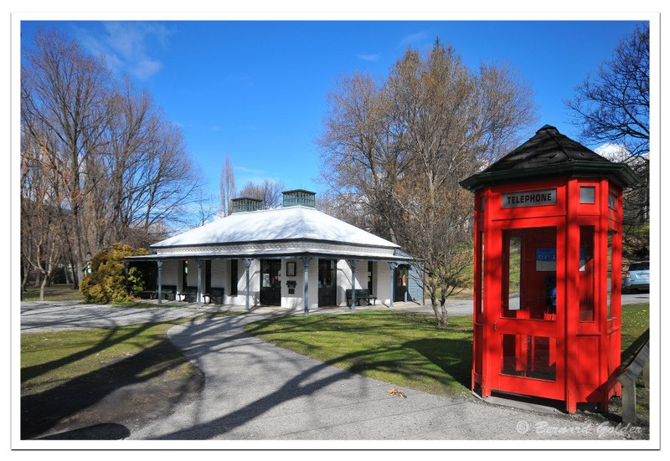
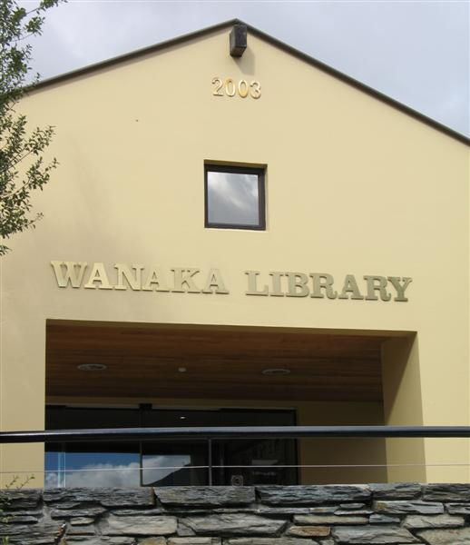
Findings - Opening hours
Stakeholder interviews, community survey, and other library practices point towards extended hours

Slide 23
Findings - Buildings
Satisfactory in terms of current needs
Not well positioned for the future
Require review to address demographic growth, layout for future developments and identity of each community
Notes:
except for parking (66% use private transport)

Slide 24
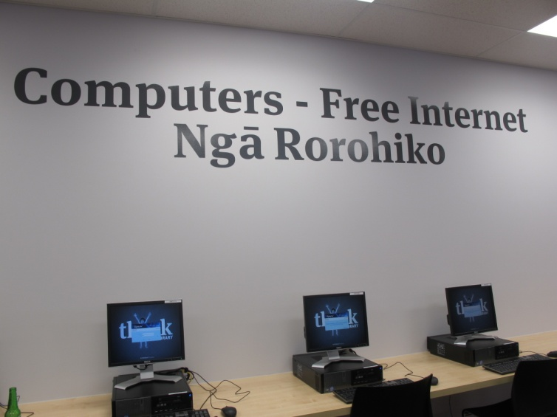
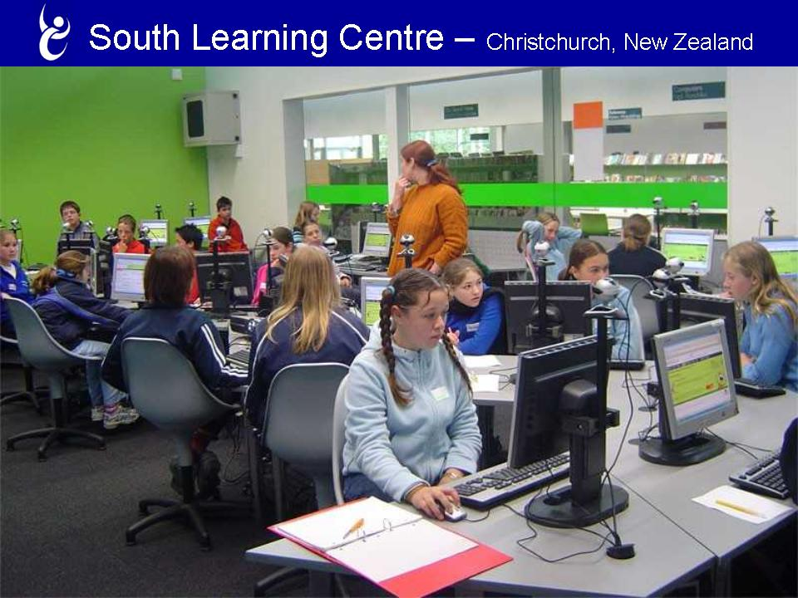

Findings –internet, WIFI
Most benchmark libraries have greater number of public computers
All benchmark libraries provide free WIFI to all members of the public in some form
Seen to be a core facility for community and visitors

Slide 25



Findings – Awareness/opportunities
Opportunities for more promotion and marketing of services
From Community survey - low awareness (55%) of E books borrowing, access Council information (58%) and access to CODC collection (67%)

Slide 26
Findings -Opportunities
From community survey, % interested new opportunities
89% - priority access to new books
83% - community learning (also supported by stakeholders interviews)
75% - research support
69% - craft activities
58% - 3 D printing

Slide 27

Findings -Systems and processes
Need to review the appropriateness of current systems and processes to ensure quality, reliability and timely information is efficiently produced
Fundamental to enable a stable infrastructure for decision making and for the future

Slide 28

Drawing it together
Review libraries for future developments and growth
Opportunities to increase usage of libraries
Overall QLDC provides a good service to the community
A number of operational improvements required - management is aware and is addressing these

Slide 29
Conclusions
The current library service is a 20th century model
  Books take centre-stage; people are perched around the fringes
  The new digital world is just starting to make headway
What works for QLDC will be a unique solution
  given its demographic profile
  and what level of service it chooses

